Slide 1
Inception
Short step to establish common vision and basic scope for the project.
It include
Use case name is identified
Critical non functional requirement
Preparation of development environment
Buy/build
Feasible
Vision
Rough cost
To generate a believable estimate or project plan

Slide 2
One week or few weeks long.

Slide 3
Artifact(work product)
Eg. Code
Text document
Diagram
Model
Db schema
Web graphics

Slide 4
Artifacts of Inception phase
Vision &business case
Use case model
Supplementary specification
Glossary
Risk list(technical,resource,schedule,business)
And risk management plan
Prototype and proof of concepts-validate technical ideas
Iteration plan
Development case –description of customized UP steps and artifacts for this project.
Phase plan and software development plan(duration and effort)
Tools,people,eduction and other resources.

Slide 5
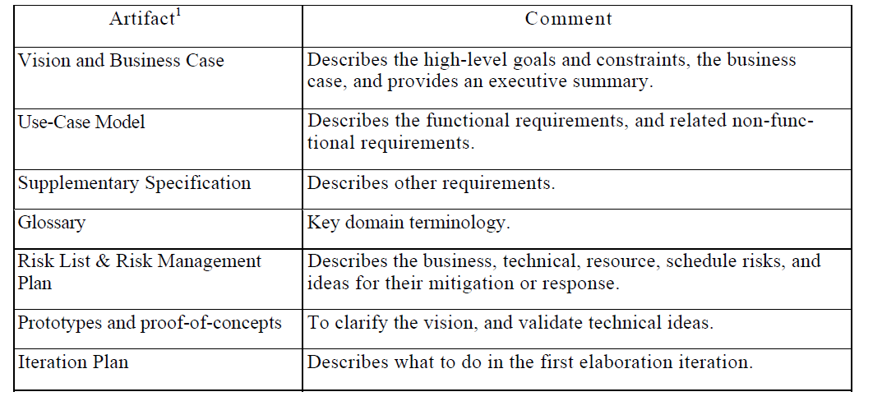

Slide 6
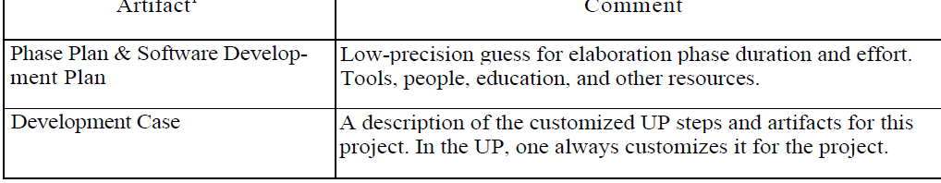

Slide 7
Requirement
These are the capabilities and conditions that the system, the project, and the product must provide and meet

Slide 8
FURPS+
Functional (features, capabilities, security)
Usability (human factors, help, documents)
Reliability (failures, recovery, predictable)
Performance (response, throughput,accuracy,availability,resource usage etc)
Supportability (maintainability, configuration,adaptability)
+ ancillary and sub-factors (next slide)

Slide 9
Ancillary and sub-factors
Implementation (includes resource limitations,languages and tools )
Interface-constraints imposed by interfacing with external systems.
Operations-System Management in its operational setting
Packaging-Physical box
Legal Requirements-licensing

Slide 10
Require artifact
Use case model
SS
Glossary
Vision
Business Rules.

Slide 11
Use case Modeling
IT is within the requirement discipline
IT is an act of writing use case .Thus it contains a set of all written use cases .
Use case diagram is optional
It is a model of the system’s functionality and environment.

Slide 12
Use case
Collection of related success failure scenarios that describe an actor using a system to support a goal.

Slide 13
scenario(Use case Instance)
Is a specific sequence of actions and interactions between actors and system.
One path through the use case.

Slide 14
Handle Return
Return an item
Item identifier not found in the system
System fails to connect to accounting system

Slide 15
Modified Definition of use case
A set of use case instances, where
each instance is a sequence of actions a system performs that yields an observable result of value to a particular actor.

Slide 16
Advantage of use case
This helps customers to contribute their defn and review.Thus lowers the risk
Simple and easy to write by expert and customers
It emphasis the user goals and perspective.
Who is using the system?
Typical scenarios to use
What are their goals?

Slide 17
3 formats of Use case
Brief-one paragraph summary usally main success scenario
Casual –Informal paragraph format
-mulitple para
Fully dressed-all steps and variations are written in detail and there are supporting sections ,like pre and post condition.

Slide 18
Use case template-Fully Dressed use case format
Use case Name-start with a verb
Scope-SUD
Level –user goal or subfn
Primary Actor-call on the system to deliver its services
Stakeholders and Interests-who care about the use case and what do they want
Minimal Guarantee(pre)-What must be true on start

Slide 19
Success Guarantee-What must be true on successful completion
Main Success Scenario-A typical unconditional happy path scenario of success
Extensions-Alternate scenarios of success or failure

Slide 20
Special requirements –related non functional requirements
Technology and Data Variations-varting I/o methods &data formats.
Frequency of Occurrence-Infulence investigation,testing and timing of implementation.
Miscelleneous-Open Issues (various business decisions)

